Slide 1
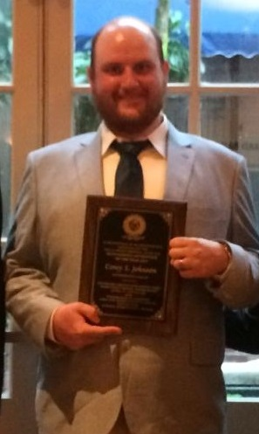
Corey Johnson
2016 Graduate

Slide 2
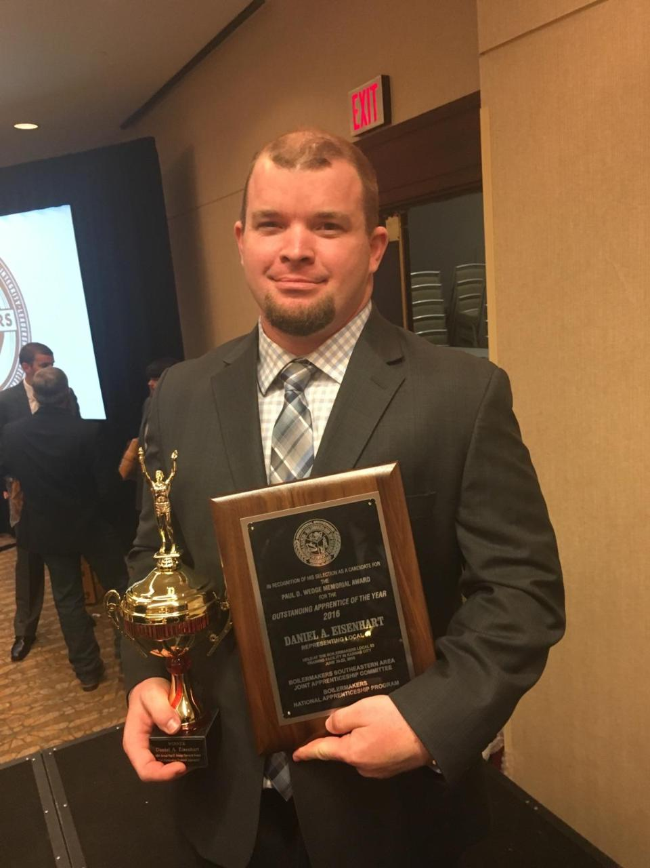
Daniel Eisenhart
2015 Graduate

Slide 3
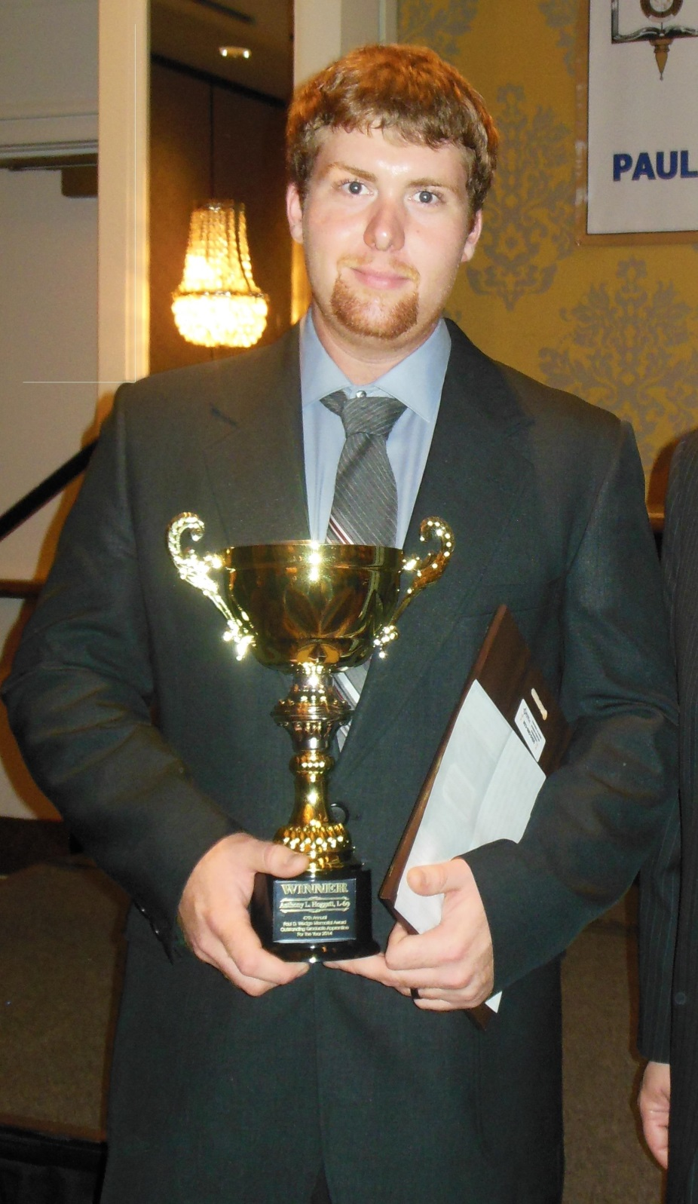
Anthony Hoggatt
2014 Graduate

Slide 4
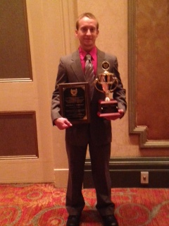
Michael Hammer
2013 Graduate

Slide 5
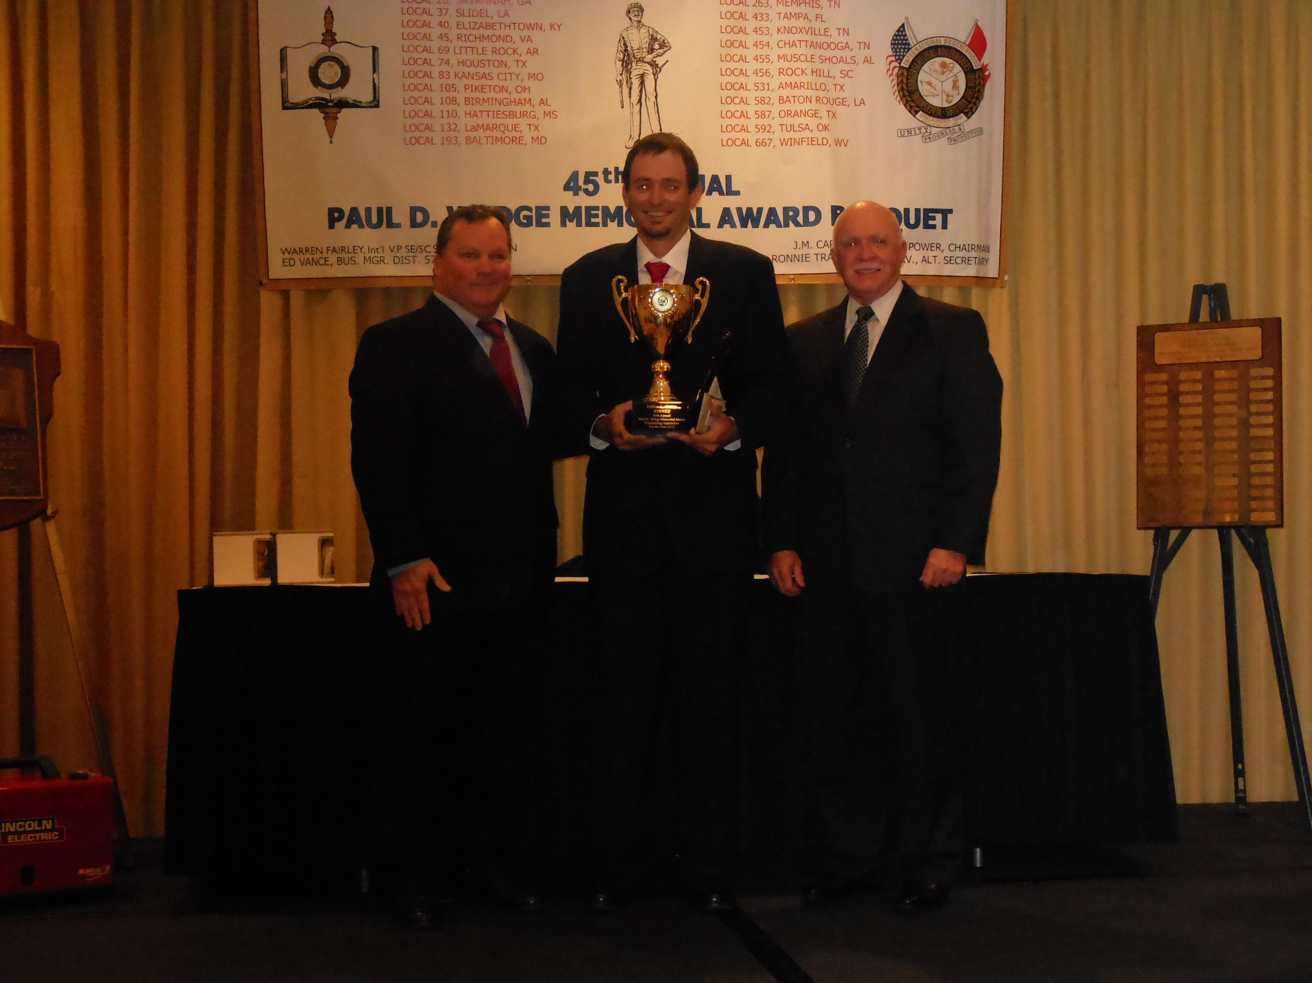
Joshua Carter
2012 Graduate

Slide 6
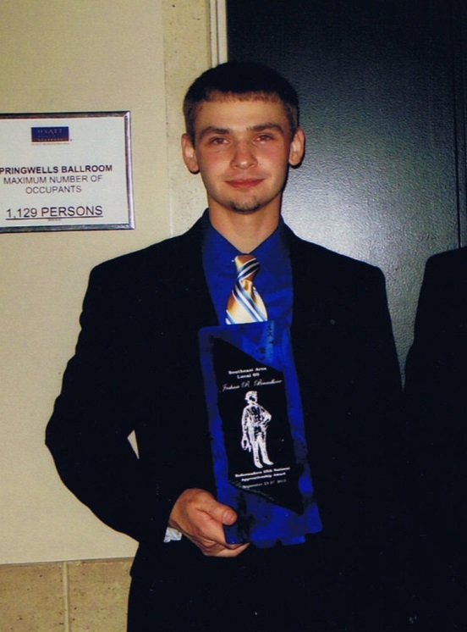
Joshua Breedlove
2011 Graduate

Slide 7
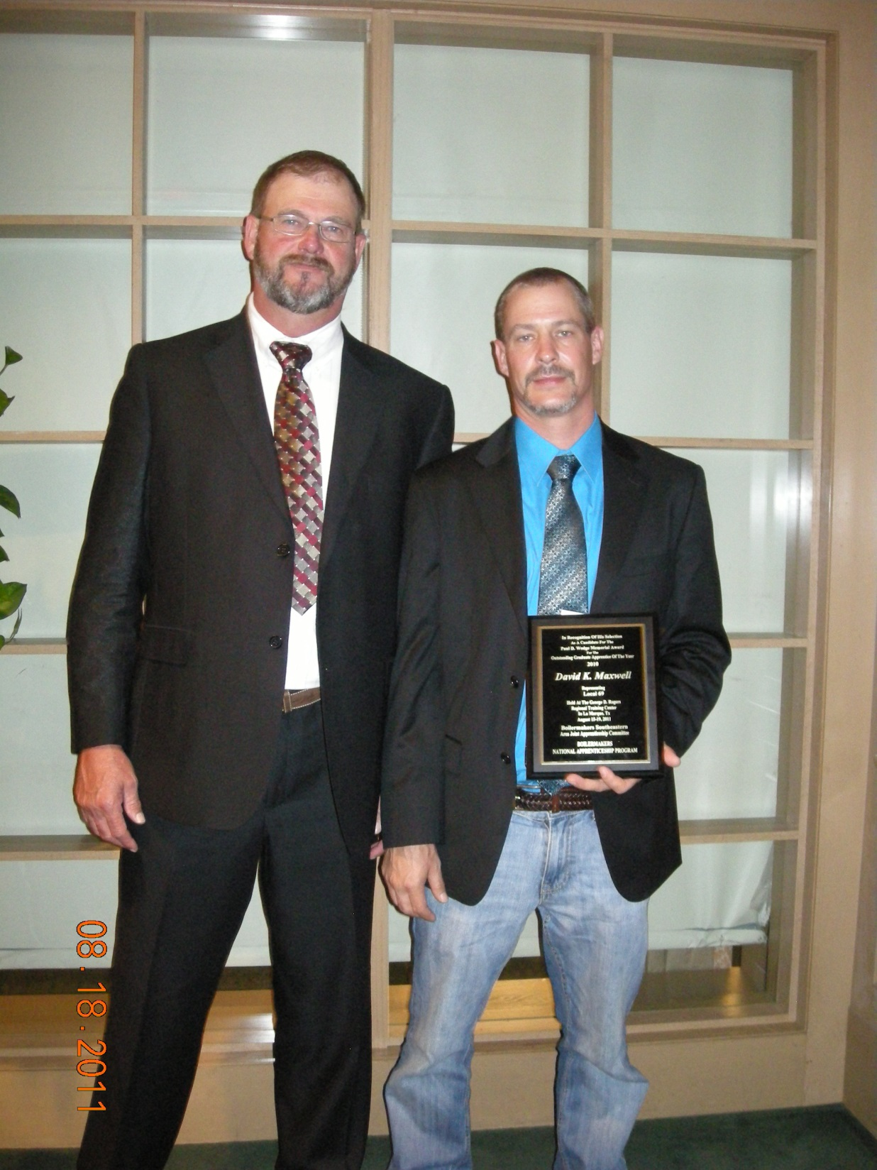
David Maxwell
2010 Graduate

Slide 8
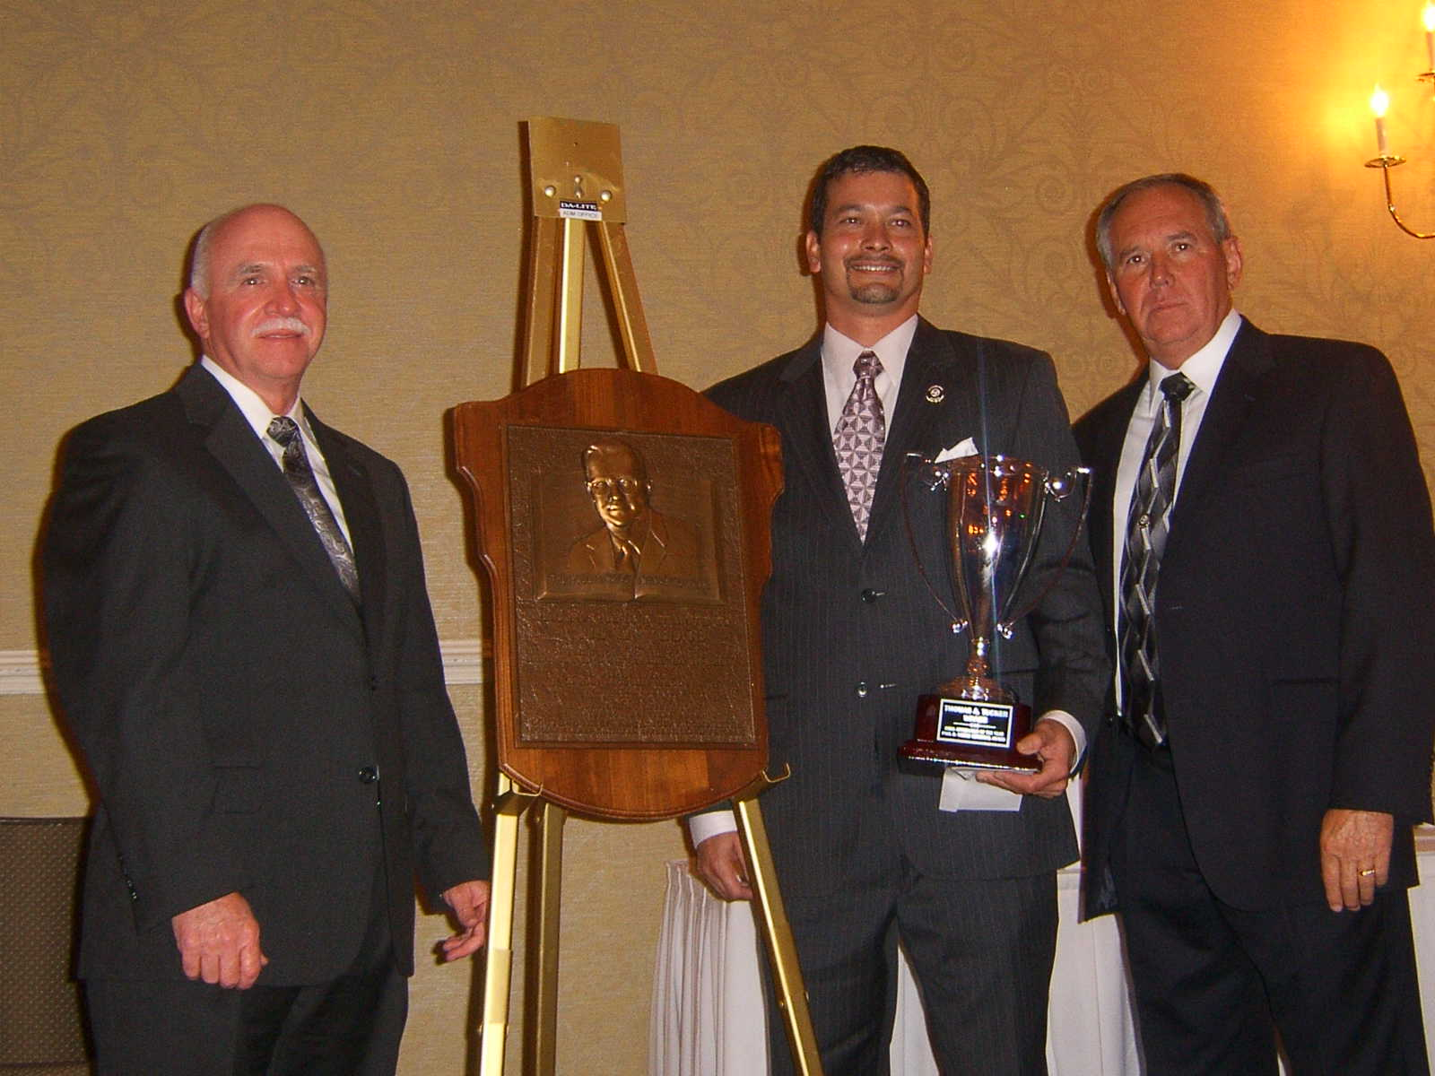
Thomas Tucker
2008 Graduate

